Slide 1

TFR
The Foreign Residents in the TRNC
Caroline Houghton – Deputy Chairman of the TFR

Slide 2

5 Year Residency Exemption for over 60 years
Who can apply?
Property Owners or Spouses/Partners of Property Owners who are over 60 years of age
Property Owner must have an individual kocan or Recent Contract of Sale and Permission to Purchase reference number & bar code if applicable.
Current residency must have expired after 14th June 2024
Who can’t apply?
Renters
Property Owners with a shared/land kocan
Property Owners who purchased several years ago who do not have title deeds
Anyone who’s residency expired before 14th June 2024

Slide 3
Application Process
Documents Required
  Copy of passport photopage
  Muhtar’s letter (Ikamet Belgesi) – issued by your local muhtar with 7.2tl stamp attached.
  Title deeds for your property (Kocan) or Contract of sale with stamps showing that it has been registered at the land registry office and your permission to purchase (Council of Minister’s Application to obtain Title Deeds) reference details.
    If you purchased the property prior to 2022 this is a square of paper with a stamp and a reference number for your application. If you applied for permission to purchase after November 2022 then this will be an A4 sheet of paper with your reference number and a bar code.
    You must have paid > 1/3 of the purchase price, if you have not yet paid in full for your property
  Proof of Pension, either pension document or bank statements showing you receive a regular pension. If you do not receive a pension, then you may need to show you have some savings in a TRNC bank account.
  Marriage certificate/Single Person’s Status from your home country if you are being sponsored by the Property owner
  Certificate of Population Registration Certificate (Nufus Kayıtı) Turkish citizens only
  Residency permit fee – 38.70tl stamp
Application
Documents
Exemption Certificate
1week before residency expires at Immigration in the Interior Ministry in Lefkoşa
No appointment required
Issued when you apply
Either stamp in passport or separate paper with the exemption
Similar to existing Residency Process
Note: there is no option to purchase State Emergency Health Insurance

Slide 4
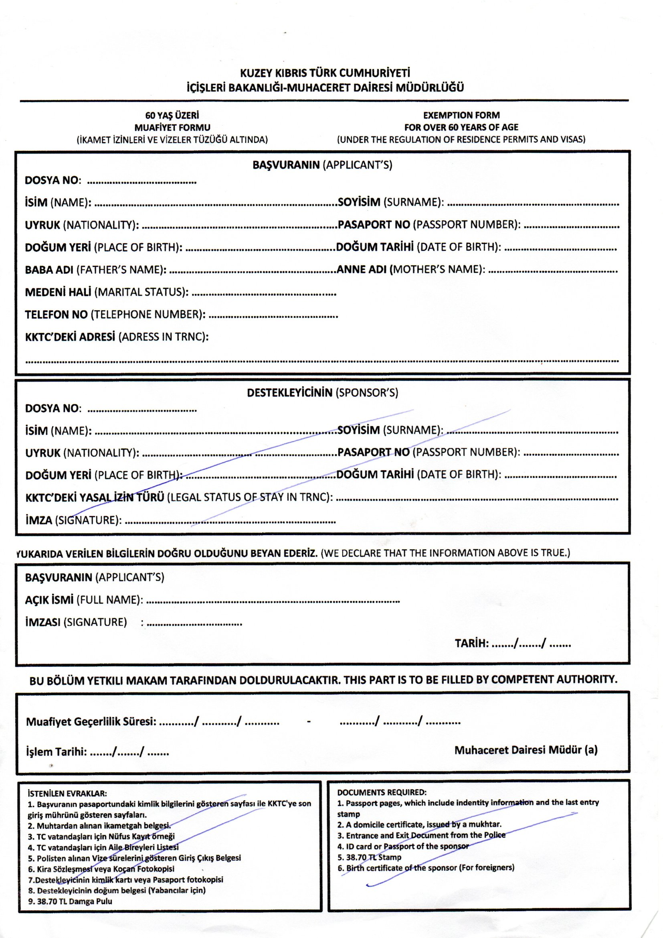
Application Form
Completed at the Interior Ministry when you apply
If you are the Main Application / Sponsor you complete the Top section of the form only
If you are the Sponsoree then you complete the 2nd section of the form.

Slide 5
Residency
Current Requirements
October 2019 Visa & Temporary Residency Law
  There has been NO law change
  Law states:
    Immovable Property – 1 x minimum wage (40,436tl = £925) / month
    High Income – 3 x minimum wage (121,308tl = £2,785) / month
    Can be either monthly income / savings / mix
  Recent Changes
    Increase in the Minimum Wage means money required has increased significantly
    Savings – must have been in a Cypriot Bank Account for 6 months OR since your residency expired whichever is the longer
      Immovable Property £11,100 / 13,330€
      High Income £33,420 / 40,134€
TFR - The Foreign Residents in the TRNC

Slide 6
Changes to Requirements
> 60 Years old
  If you have a pension – 6 months bank statements from your home country or
  Savings in a TRNC Bank Account
  For Renters with a UK passport and pension the requirement is only 1 x minimum wage
< 60 Years old
  Savings in a TRNC Bank Account
  Income
    monthly income must be paid into a TRNC bank account
    Ideally you should show a single payment every month which meets the income requirement

Slide 7

Residency Permit – Requirements & Timescales
Register / Renewal
1st Registration must be completed before visa expires
Renewal cannot be started until 20 days before existing residency expires
Police Visit
Requirements: depends on circumstances
Health Insurance / Blood Tests
Paid online International credit or debit cards can be used
Following payment if <60 years old system will advise clinic to attend for Blood tests.
Residency Permit
Pay Stay Permit
Paid online, International credit or debit cards can be used
Indicates residency permit approved
After paying for your permit. Logout and login again and your permit is available to download and print off
SMS message notifying date of police appointment received -considered registered
Application: 20% complete
Police take Paperwork and advise to continue online
Application: 50% complete
Health Insurance paid and Blood tests (if required) uploaded to system
Application: 60% complete
Pay Stay Permit and print receipt for payment if desired
Application: 70% complete
Residency Permit can downloaded & printed from system
Application: complete
4/5 week
6 month permit < 1 day
1 year permit < 1 day
2 years permit < 2/3 week
No Blood Tests 3 weeks
Blood Tests – up to 10 days to upload test results + 3/4 weeks
Immediately – logout and login and your residency permit is available
Approximate
Timescales
Total = 9-12 weeks

Slide 8
Requirements
Photocopy of Passport Photopage
1 x passport sized photo
Original Muhtar’s Letter with 7.2tl stamps
Last Residency Permit / Last entry Stamp (initial applications)
Bank Statements
  6 months up to date showing pension
  6 months up to date showing savings
Sponsor / Sponsoree
  Married - Copy of Marriage Certificate / Legal Partnership
  Cohabiting - Single Person Status Declaration & Partnership form from Notar
  Child > 18 years – Birth Certificate & Single Person Status Declaration
    Needs to show an income of 1 x minimum wage (income or savings)
Note: If you are applying as a couple – both people need to provide a pack of papers.
The Sponsoree’s pack must include a copy of the Sponsor’s Information (Passport & Bank Statements)

Slide 9
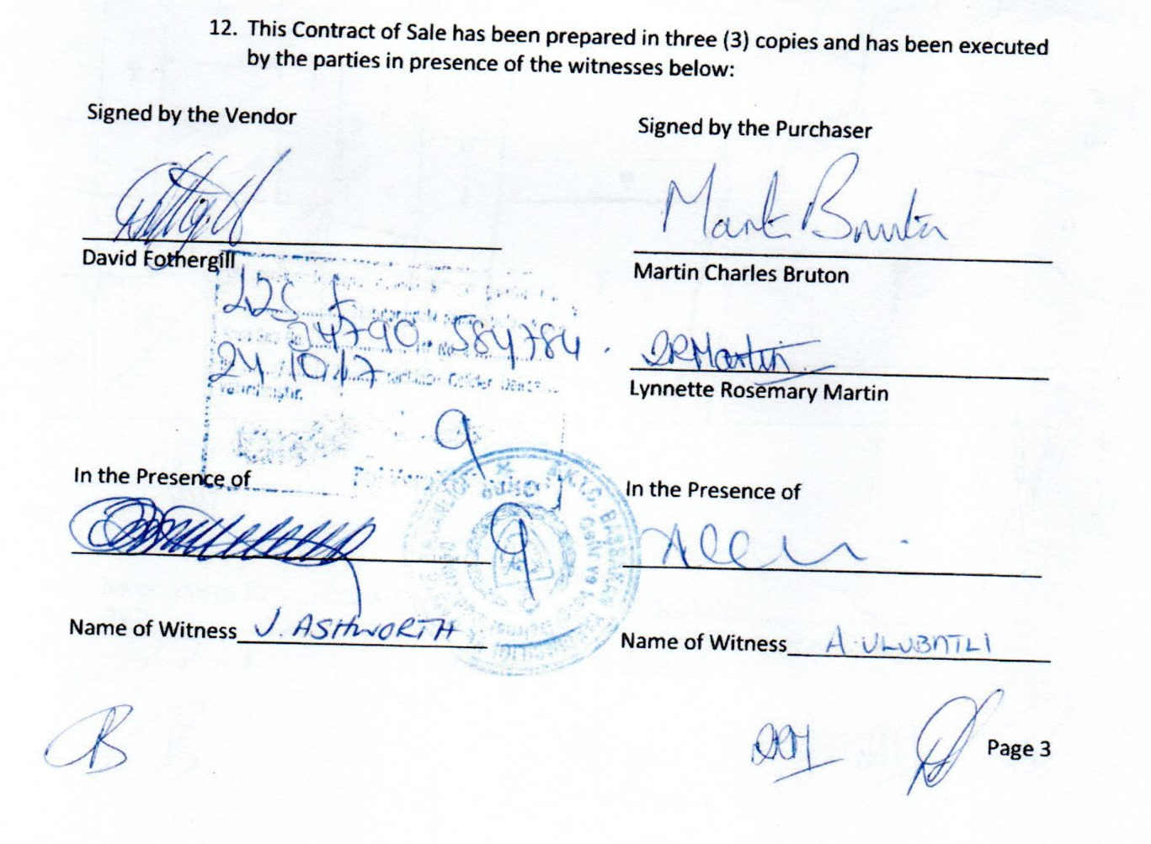
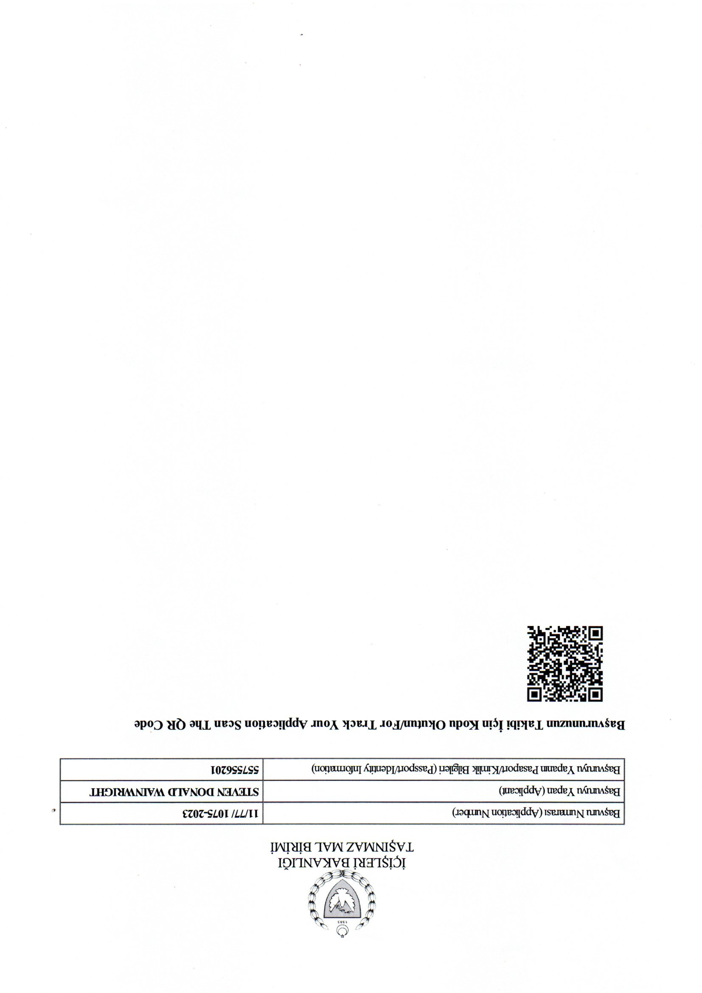
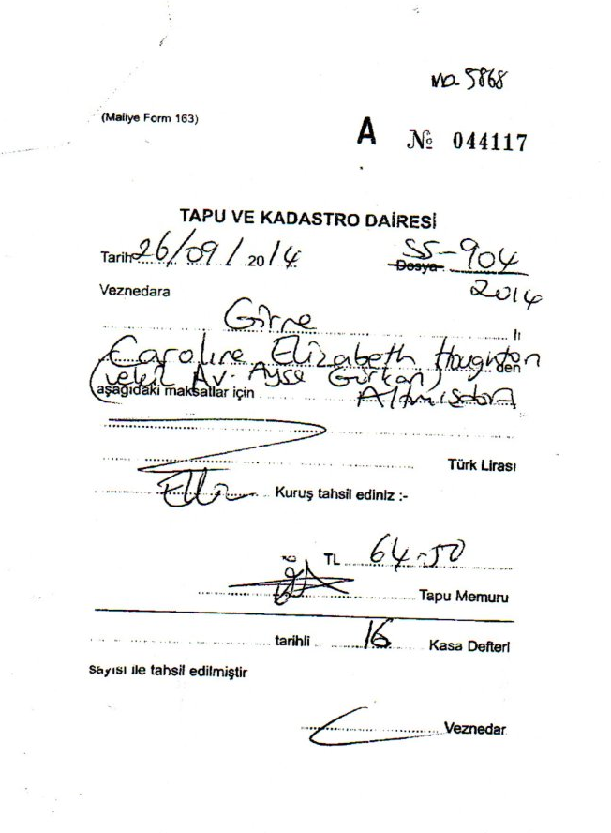
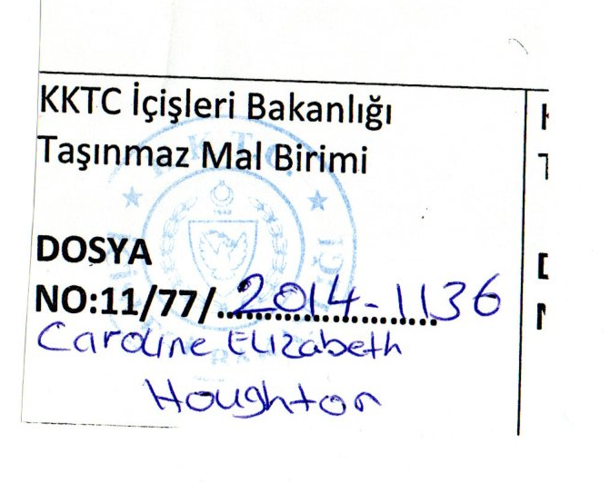
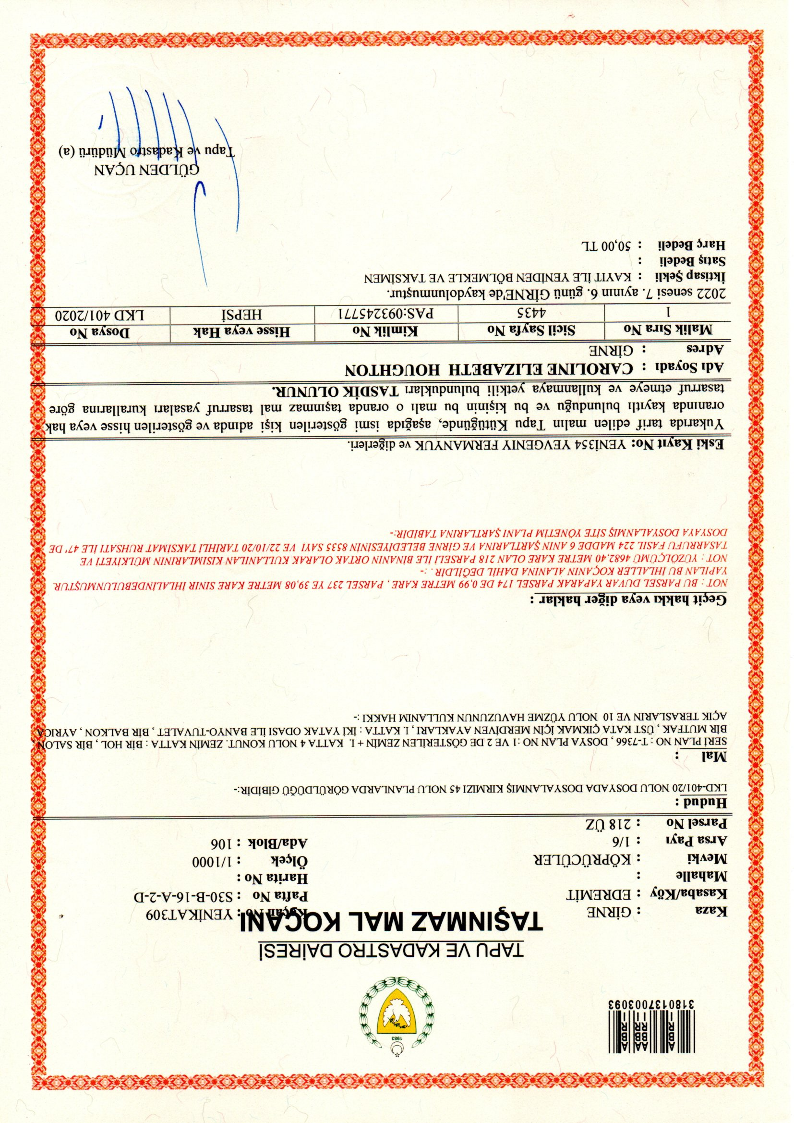
Requirements
Home Ownership Documents
  Immovable Property
    Kocan – must list the details of the Property
    Land Kocan – must also supply original Contract of Sale
    Contract of Sale with Tax Office/Tapu Office Stamp + Permission to Purchase Reference Number
      P2P must be system printout with QR Code or Stamped Square of Paper from Tasinmazmal Dairesi
      Copy of the Receipt from the Land Registry that you registered your contract of Sale
    1 x Utility Bill – Electricity, Water or Property tax
  Rental
    Contract with Official tax office stamp
    Properties bought in trust are treated as Rental
    Leasehold Properties are treated as Rental
  Property Owned by 1st Degree Family Member
    Letter from Property Owner stating they have authorised you to live in the property free of Charge + Photocopy of their Passport
    Letter must be stamped by Tax Office (tax Office requires a copy of Birth Certificate or other Official Documents to prove familial link)
Note: Bring originals of documents as well as copies in case police request to view

Slide 10
Travelling Whilst Residency is in Progress
Visa You can travel outside TRNC if your visa is still valid. Online application must be made before visa expires
Online Registration following receipt of sms notifying of police appointment you are considered registered. You can stay in the country legally, but you cannot leave the country before your police appointment
Health Insurance / Blood Tests should be paid within 14days of notification
Residency Complete legal permission to remain in the country until expiry date of your permit
Residency Permit Payment should be paid within 14 days of notification
Police Appointment Formal registration point. Once the police have accepted your paperwork you can travel outside the country provided it is <60 days since your police appointment
20%
50%
0%
60%
70%
100%
Notes:
20% - if you need to leave the country before your police appointment you MUST go to the police station <7 days before you intend to travel with evidence of your travel plans i.e. flight tickets. The police will take your papers and your application will move to 50%. You can then travel without risk of a penalty
60% - if you need to leave the country and it is >60 days since you attended the police station and your papers were accepted you MUST complete your residency application before you travel. To complete your application you should visit the Interior Ministry in Lefkosa and report to the Reception windows and request for your residency to be completed.
Note if you intend to travel < 60 days after your police appointment the Interior Ministry will not progress your residency, as you do not need your residency to be completed in order to travel
If you leave the country before your residency is completed, your application may be issued while you are away, however it will only be issued up to the date you left the country. When you return you will be given a 30 day visa to enter the country. You should then go to the Interior Ministry and request your residency is extended for the full period you paid for.

Slide 11
Buying Property Taxes
New Property
Resale Property
Contract Registration – 0.5%
Transfer Tax – 12%
  6% paid at Contract Registration
  6% paid when Title Deed (Kocan) transferred
5% VAT (KDV)
Service Connection Charge - £2,100
  Deposit for Water & Electricity
Contract Registration – 0.5%
Transfer Tax – 12%
  6% paid at Contract Registration
  6% paid when Title Deed (Kocan) transferred
Deposit for Water & Electricity

Slide 12

Selling Property Taxes
Stopaj / Capital Gains Tax – 4%
  Payable if you have previously sold a property and exercised your 1 off right to waive this fee
  Payable by Developers
Stopaj / Capital Gains Tax – 2.8%
  Payable if 1st Property Sale
  Payable for all properties if the owner has taken Title Deed (Kocan) but has never occupied the property for > 6 months in any calendar year
Waive Stopaj
  Can be waived, if 1sr property sale and you have lived in it for >6 months in a calendar year.
  Residency permit or ins & outs report as proof
Note: Annual property tax must be paid up to date for sale to complete

